Slide 1

MBA/PGDM ADMISSIONS Batch 2025-27
www.iibs.edu.in
www.iibsonline.com

Slide 2

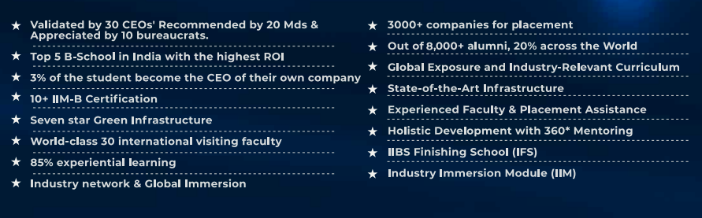
Why IIBS…?

Slide 3

Our Mission & Vision
Vision
“To inculcate ethical values and provide innovative, holistic learning experiences that nurture individuals into well-rounded human beings, thereby equipping them to become influential global leaders.”

Slide 4
Mission
To encourage the students with modern education to bring economic emancipation and social transformation.
To provide the resources and opportunities to create global leaders.
To provide holistic approach to prepare the students to grow personally, professionally, socially and emotionally and to make them a complete human being.
To redefine the student’s talents to make them successful entrepreneurs and responsible citizens.
To develop great human beings with values and ethics.

Slide 5



Importance of Location Bengaluru
Placement opportunity
Silicon Valley (IT Hub)
MNC – Head Offices
Industrial Exposure
Corporate Guest lecturers
Highly experience professors
Cosmopolitan City

Slide 6
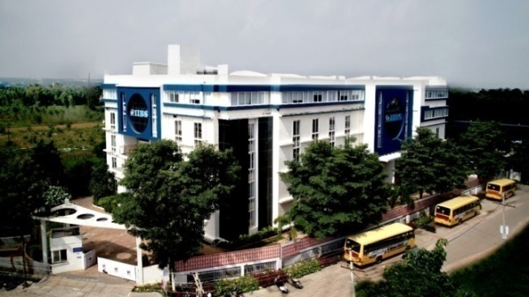
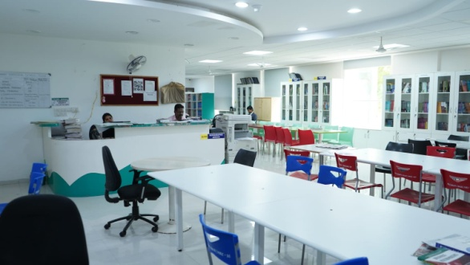

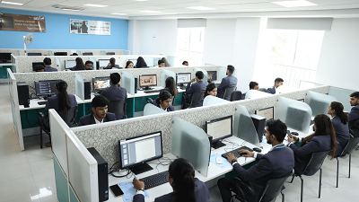
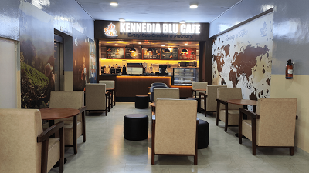
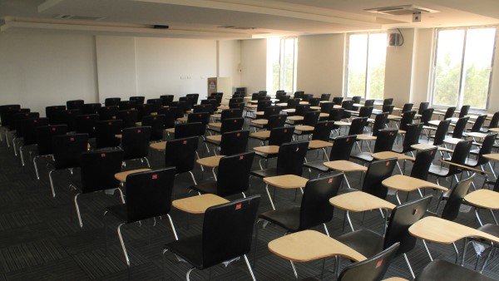
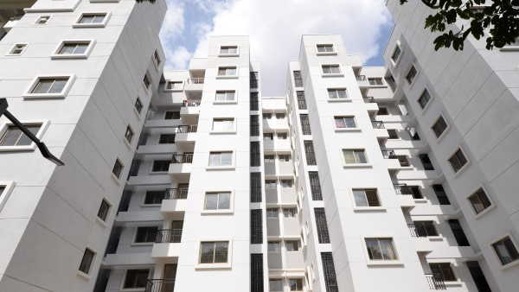
Infrastructure

Slide 7
Approval and Accreditation
Accreditated by NAAC"A" Grade
Approved by AICTE, Ministry of Education & Government of India.
Affiliated to Bangalore City University (BCU), Approved by UGC (2f)
Association by ASSOCHAM
Association with AIMA
Association with Confederation of Indian Industry (CII)
Association with AIMS

Slide 8
Institutional Ranking
Most Remarkable Bangalore Institutes of the Year 2024 [August 2024]
By- Education View India
India's Top 50 Non IIM's B Schools Ranking Survey 2024 By -THE ACADEMIC INSIGHTS
India's Top 50 Non IIM's B Schools Survey 2023" (Ranking Edition June 2023)
By -THE ACADEMIC INSIGHTS
Karnataka Top 20 Educational Institute Survey 2023(Ranking Edition June 2023)
By-THE ACADEMIC INSIGHTS
College ofthe Year 2022 Review- Dec 2022 (Source: The Higher Education Review)
Top Prominent B School of India- Survey CSR -2022
(Source: Competition success review)
Beyond IIMs, IIBS stands in 3rd Position under 100 top MBA Colleges in India. - Survey 2021
(Source: The Higher Education Review)
Top MBA College in Bangalore in Terms of Placement- Survey 2021
(Source: Digital Silhouette)

Slide 9
India’s Most Preferred MBA College Source Best Choice Survey Jan 2019 & Oct 2022
Ranked 4th in Placement among the Best B School in India -Silicon India 2020
Ranked 2nd B-Schools in Bangalore By CSR Annual
Ranked 8th All India by Parivartan Times Annual B-Schools Survey
Ranked 14th All India by Campus Option Annual B-School Survey
Ranked 5th TOP B-School in South Zone by THE WEEK
TOP 11th B-School in India by B-School of Excellence in India
Top 25 B-School in India by BUSINESS WORLD

Slide 10
Why IIBS is Different From Others ?
15%
MBA/PGDM
Course Theoretical
85%
Experiential Learning (IFS)

Slide 11

IIBS Finishing School (IFS)

Slide 12
85% IIBS Finishing School
Skill Development
Experiential Learning
Certifications

Slide 13
Skill Development
Communication
Placement Training
Aptitude Test
Group Discussion
Personal Interview
Personality Development
Grooming
Case Study
Seminars
Presentation Skills
Club Activities
Resume Writing
Six Months Live Digital Marketing Training
Live Data Analytics Training

Slide 14
Experiential Learning
MOM
ALP
Surface
12 Industrial Visits
International Tour and Student Exchange Programs
Mentoring (4 Levels)
Sports activity
Certifications Courses
Club Activities
Western Ghats Trekking
Southern Indian Railway Tour
Rural Connect
Internship
Entrepreneurship & Start-up
4 International Exhibitions Visits in India
4 International Boot Camp
30+ Professionalism Building Activities

Slide 15
Certifications
IIBS Provides total 86 Certification along with MBA/PGDM
12 From Harvard Business School
10 Certification Courses by IIM Bangalore
56 Certification from IIBS and Other Corporate
8 General Certification from IIBS and Other Corporate

Slide 16
Library Information…
LIBRARY DETAILS
SL No. | Titles | Volumes
1 | Total No. Of Vols. | 24507
2 | Total No. Of Titles | 5452
3 | Total Journals | 30
 | National Journals | 24
 | International Journals | 6
4 | Daily Newspaper | 14
5 | Library Automation Software | Easylib Automation Software
6 | E Resource Database | J-gate
 |  | Proquest
7 | EBSCO E-books | 12000 Plus Titles
8 | Membership | Delnet
 |  | NDLI
 |  | IIM Bangalore

Slide 17
Faculty Information & Contribution Points
Faculty Profile
Faculty Profile
Qualification | CAY | CAYm1 | CAYm2
PhD | 20 | 10 | 9
NET | 7 | 3 | 3
PG | 18 | 9 | 7
Total | 45 | 22 | 19
Qualification | Professor | Associate Professor | Assistant Professor | Total
Ph.D. / NET | 3 | 6 | 18 | 26
PG | 0 | 0 | 18 | 18
Total | 3 | 6 | 36 | 45

Slide 18
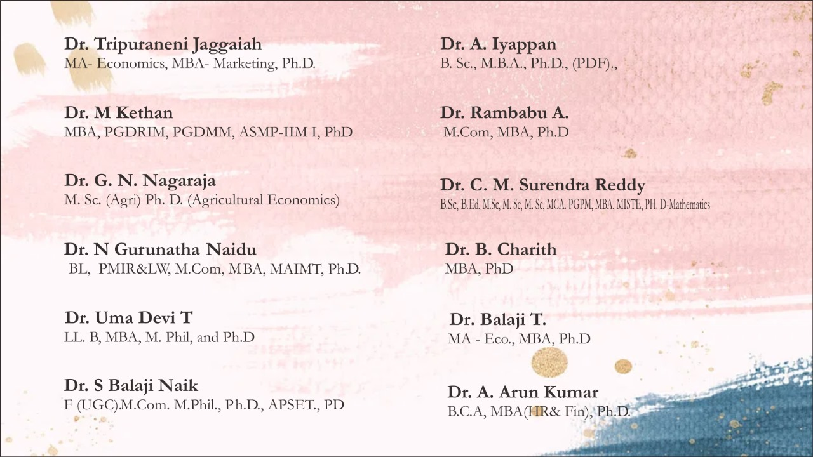
Faculty Details

Slide 19
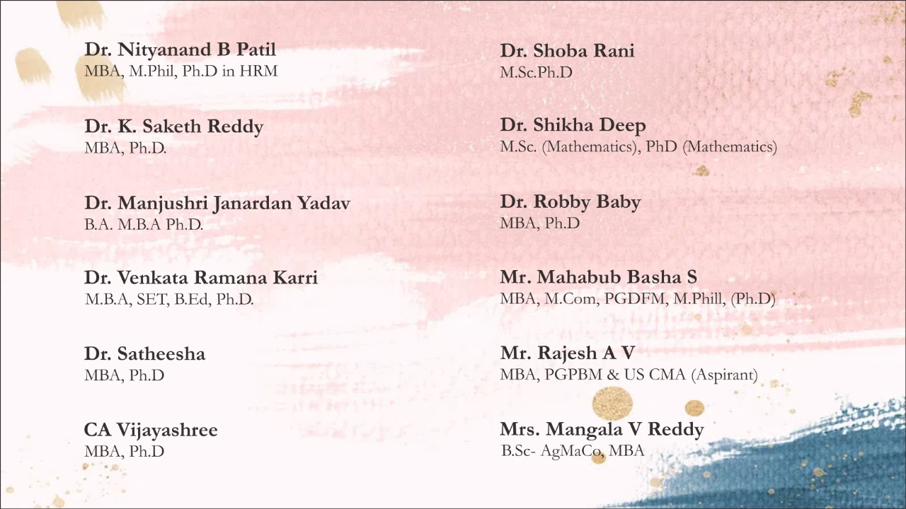
Faculty Details

Slide 20
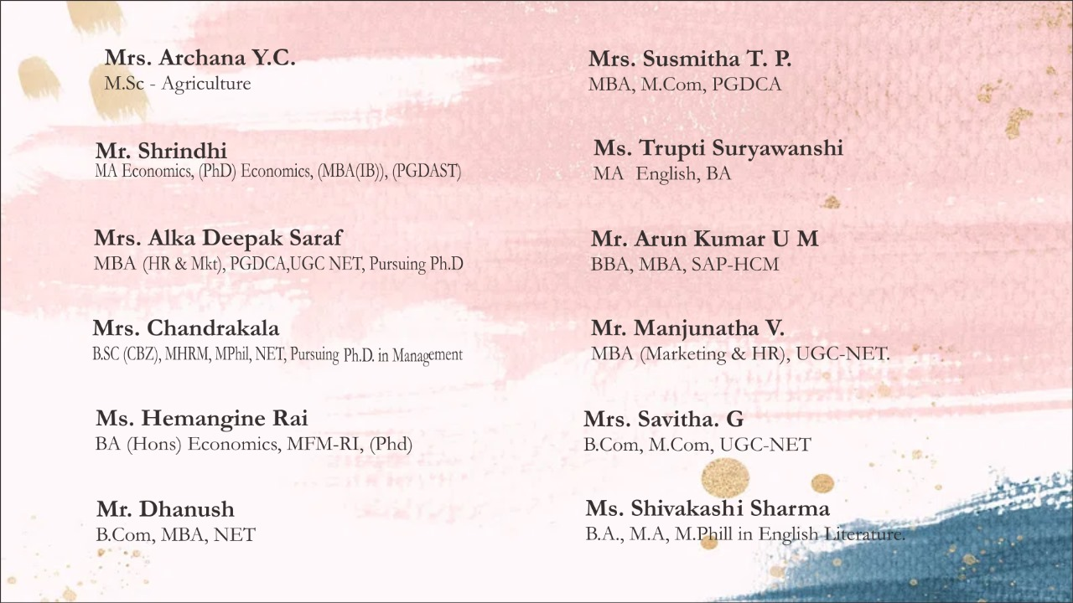
Faculty Details

Slide 21
Faculty Diversification
Gender Diversity Regional Diversity
Description | CAY | CAYm1 | CAYm2
Male | 26 | 15 | 11
Female | 19 | 7 | 8
Total | 45 | 22 | 19
Karnataka | 15 | 10 | 11
Non- Karnataka | 30 | 12 | 8
Total | 45 | 22 | 19

Slide 22

Teaching Methodology
30 % syllabus taken by corporate peoples

Slide 23
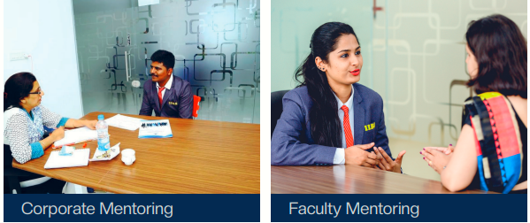
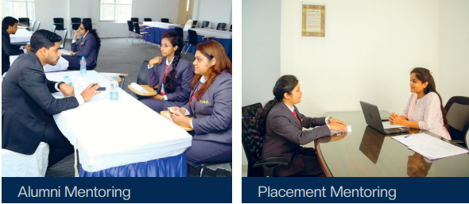
Mentoring 4 Levels

Slide 24
Extension & Outreach Programs
Blood Donation- camp
Orphanage Visit
Awareness on Blood Donation
Personal Hygiene
Awareness on Reducing Plastic Usage
Voter Awareness
Industrial Visits
Sports
Girl Child Protection
Rural Literacy
Swatch Bharat Abhiyaan
Environmental Awareness
AIDS Awareness
Drug Awareness
School Adoption
Road safety Workshops
Management Fests
Inter College Competition
Student Exchange Program

Slide 25
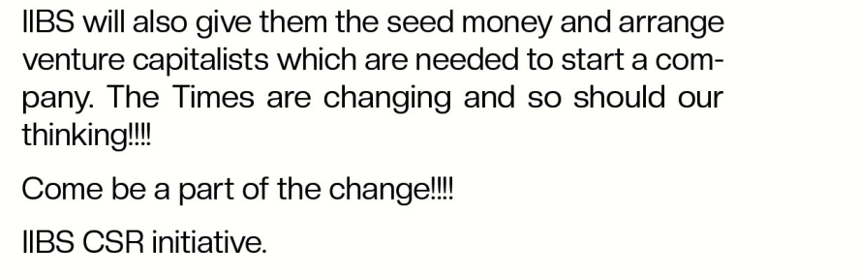
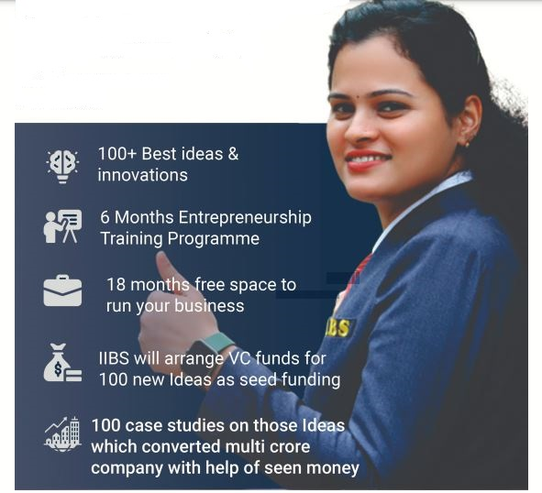
Entrepreneurship & Start-up

Slide 26
Management Orientation Month (MOM)
OBJECTIVES
To be familiar with growth in a prosperous environment
To provide an opportunity and to identify themselves among others
To share their inhibitions in a congenial environment
To be aware of their areas of improvement when compared to the expected levels of the corporate world.
To develop human relationships with group dynamism.
To mold them to get the basic knowledge to take up the PGDM programs in full swing
To enhance their confidence to communicate with others
To identify and explore the capabilities by utilizing their potentials.
To bridge the gap through a finalized and focused path of success for their achievement.

Slide 27
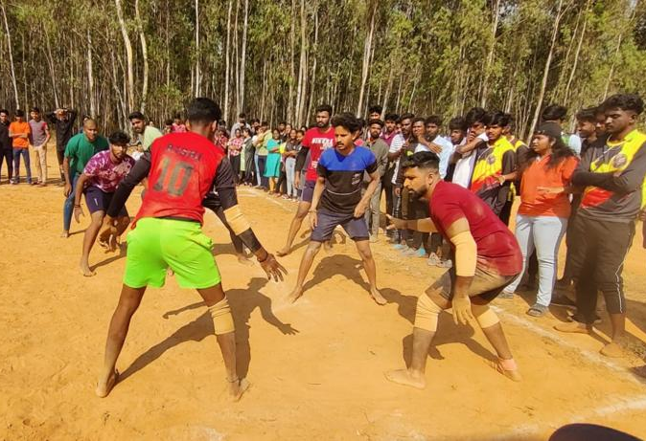
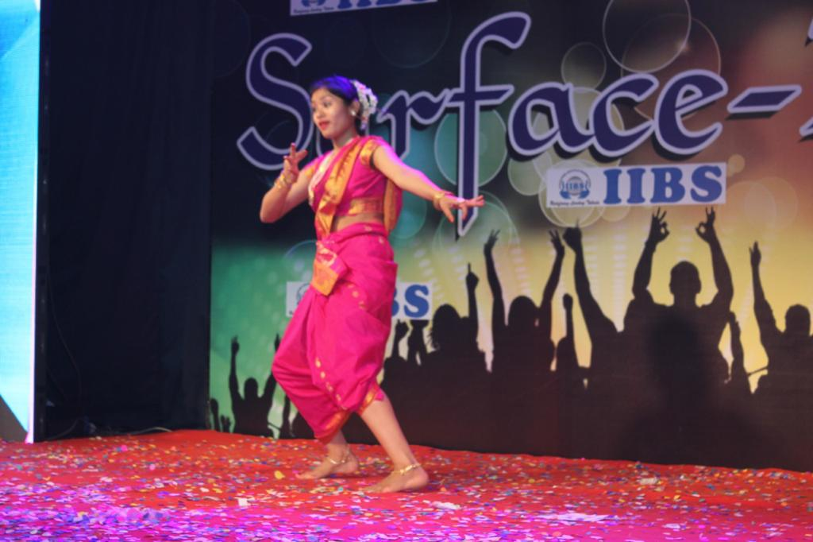
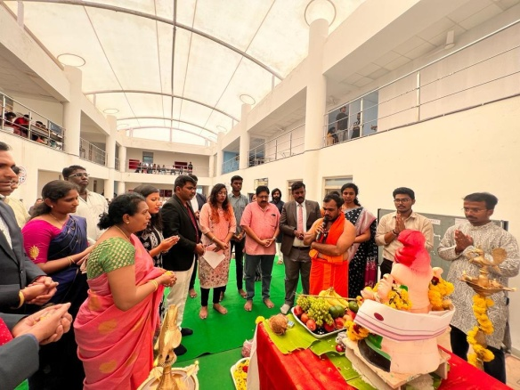
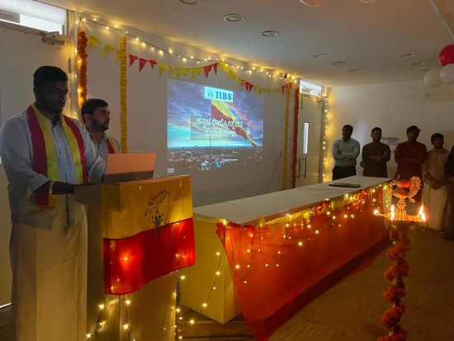
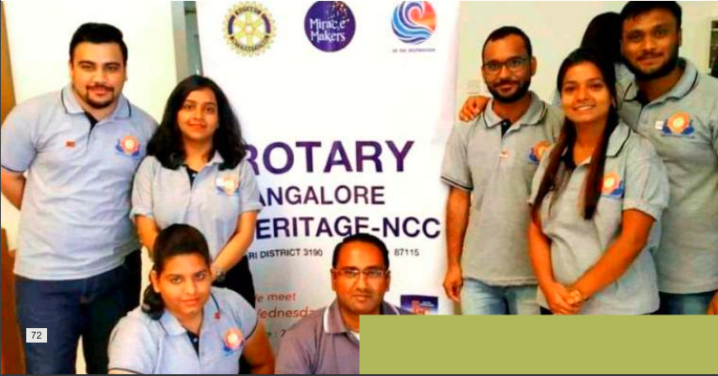
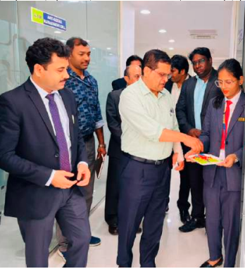
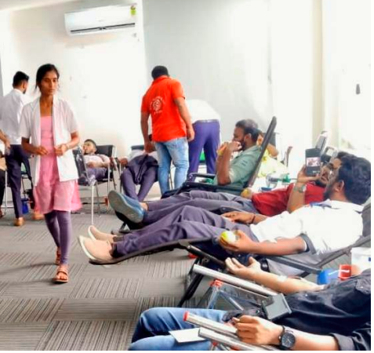
Club Activities
IIBS Chairman’s Club
ISR Club
Agri Club
Marketing Club
Cultural Club
Sports Club
Research Club
Finance Club
Rotract Club
Entrepreneurs Club

Slide 28

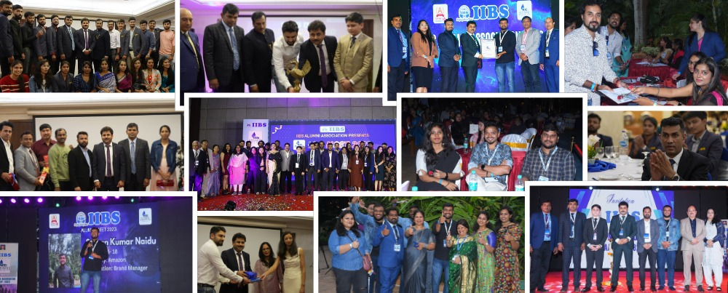
IIBS Alumni Association (IAA)
Out of 8000+ Alumni , 20% across the world
Networking and Reconnection
Recognition and Celebration
Career Support and Mentorship
Knowledge Sharing and Community Building
Feedback and Institutional Development
Engagement, Cultural and Social Activities

Slide 29
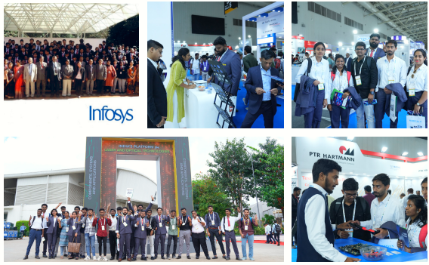
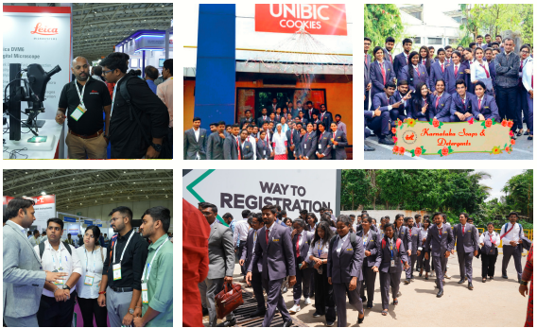
Industrial Visit

Slide 30
International Collaboration
Inti International University – Malaysia
San Beda University – Philippines
Universitas Bengkulu – Indonesia
Ho Chi Minh University of Banking – Vietnam
USCI University – Malaysia
University of Wolverhampton - UK

Slide 31
PGDM Specialization
(Dual Specialization)
1. Marketing
2. Finance
3. Human Resources Management
4. Business Analytics
5. Production and operation management
6. Entrepreneurship and start-up
7. Agri Business Management
8. Logistic & supply chain Management
9. Data Science
10. Information Technology
11. International Business
12. Health Care Management
13. Hospital Management
14. Artificial Intelligence and Machine Learning (AI& ML)

Slide 32
MBA Specialization
(Dual Specialization)
1. Marketing
2. Finance
3. Human Resources Management
4. Business Analytics
5. Production and operation management
6. Entrepreneurship and start-up

Slide 33
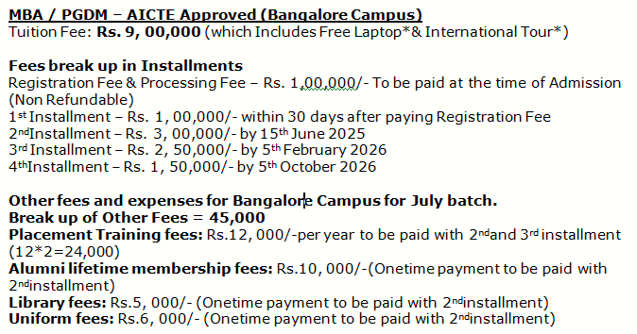
MBA / PGDM Fee Structure

Slide 34
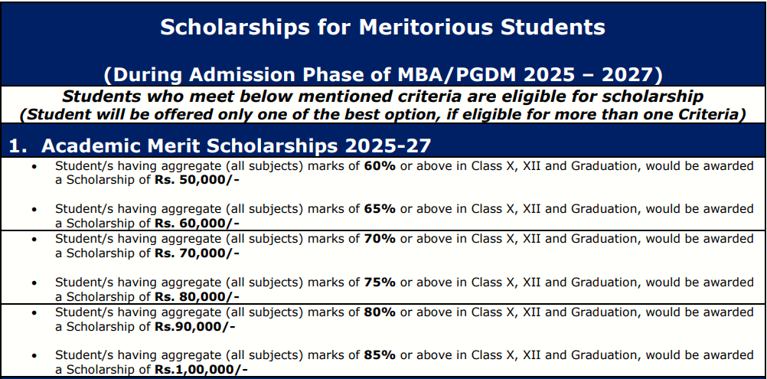
Scholarship: Scholarships are awarded to meritorious students*

Slide 35
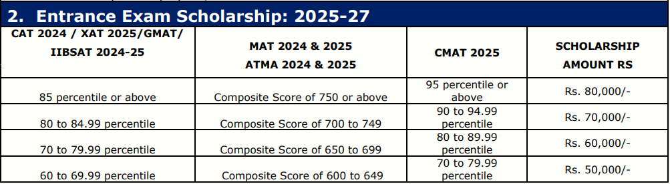
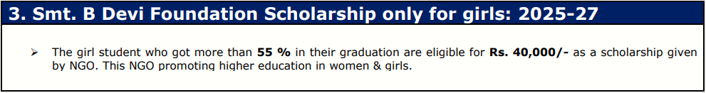
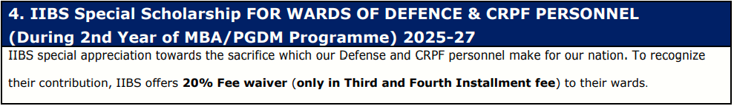

Slide 36
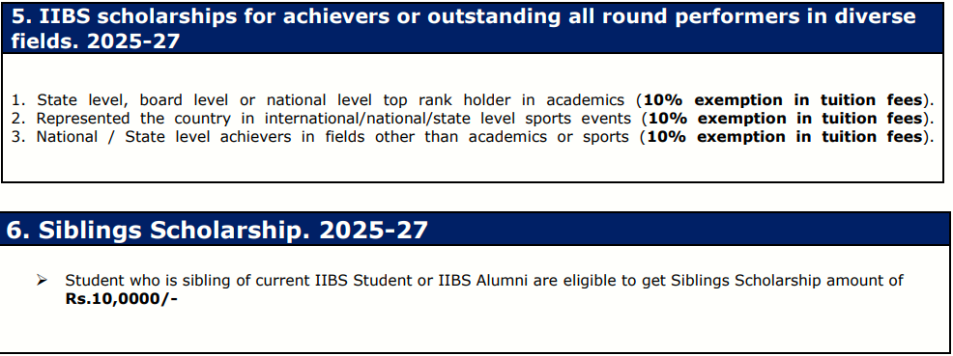
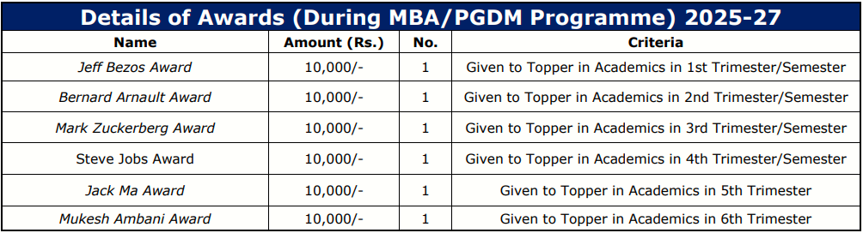

Slide 37
Additional Scholarship
All the girls students will get additional Scholarship of Rs. 20,000/- by Dr. Jay Foundation apart from all the above Scholarship.
Physically Challenged Candidates are eligible for Rs. 25000/-
Single Parent Candidates are eligible for Rs. 25000/-
SC/ ST/ OBC/ EWS/ Religious Minority are eligible for Rs. 10,000/- as a Additional scholarship given by Smt. B Devi Educational and Charitable trust Foundation subjected to submission of valid certificate issued by Govt.

Slide 38

Free International Tour & Student Exchange Program
Only 50 PGDM students are eligible for International tour those who have 80% in I, II & III trimesters of their pursuing course.
Only 50 MBA Students are Eligible for International tour who have 80% in I & II Semester of their pursing course

Slide 39


Free Laptop
*Laptop for all students who clear their 2nd installment of tuition fee in on time …

Slide 40
3 Levels of Placement
State Level
National level
International Level

Slide 41
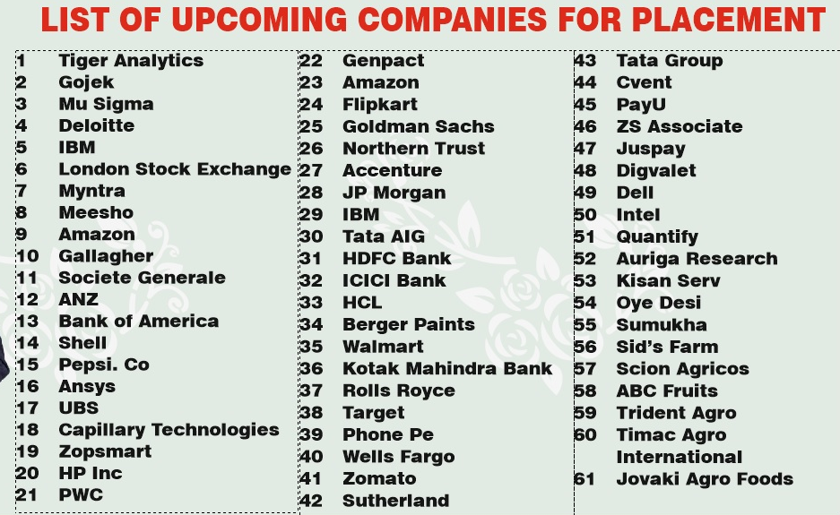

Slide 42
2022-24 Batch Placement- Companies Processed on Specialization till now
Marketing
Internz Valley
Prodesk IT & Engineering Services
AKV Technologies
Kotak Life
Brands For Brands
Incredible Devices
HFFC
Affluent Global Services
Mobiveil Inc
Berger Paints
Jaro Education
Scaler
EY India (Shree Cement)
Nandi Toyota
Cafe Coffee Day
Intelipaat
Planet Spark
Simplotel
Peepal Consulting
Para Mantra
Bajaj Allianz Life Insurance Company Limited
EXPLORE AND EVOLVE PVT LTD
Indiamart Intermesh
HFFC
Prop Times
EWK Homes (Dubai)
Manupatra
Growth Arrow
My Gate
360 Realtors
SCS India
SCITECH PATENT ART SERVICES PRIVATE LIMITED
Janitri Innovations Pvt. Ltd
Derbygroup (Dubai)
Policy Bazaar
Real Time Data
My Class Board
CINCOONI Systems
Simplotel
Search Homes
Hindustan Unilever
Berger Paints
Indiamart Intermesh
Planet Spark
Bhanzu
Prop Times
Cafe Coffee Day
AADIYAH Aerospace Technology
Teach Maven
Nimesa Technology
SmartQ
MagicPin
Corizo
Campalin
Home First India
Krutanic
Pin Click
Teach Maven
PropTimes
Vestian MEA LLC Dubai
Satguru Travels & Tours
SmartQ
ICA Pidilite
MagicPin
Lulu Group International (UAE)
Krutanic
Jaro Education
PinClick

Slide 43
Finance
HFFC
Berger Paints
KPMG
EY India (Shree Cement)
Groww
Broadridge
Cafe Coffee Day
Envision
EY GDS
Bajaj Allianz Life Insurance Company Limited
HFFC
Growth Arrow
S & P Global
Derbygroup (Dubai)
Pragati Finance
William O Neil (23 Passing Out)
Satguru Travels & Tours
Ardee Industries
Broadridge Financial Solutions
Home First India
Satguru Travels & Tours
Lulu Group International (UAE)
TravClan

Slide 44
Human Resource (HR)
Prodesk IT & Engineering Services
Kotak Life
Brands For Brands
Kotak Life
Brands For Brands
Affluent Global Services
Berger Paints
EY India (Shree Cement)
EY GDS
Cafe Coffee Day
Peepal Consulting
EXPLORE AND EVOLVE PVT LTD
Aptean India Pvt. Ltd
IBS Software
SmartQ
CINCOONI Systems
Accenture
The Brand Lookbook
Flipkart
Mercedes-Benz
Astrotalk
Neeyamo
Lulu Group International (UAE)

Slide 45
Agri Business Management
Indiamart Intermesh
Indo American Seeds
Ninjacart
Big Basket
Pragati Finance
Tierra Agritech
Oye Desi
Cottanad Plantations
EF Polymer
Arya . ag
Rasi Seeds
Akshayakalpa Organics
SPMESM ( NGO)
Scion Agricos

Slide 46
Business Analytics
EY India (Shree Cement)
Swiggy
Bhanzu
Astrotalk
Lulu Group International (UAE)
Infogain
Broadridge

Slide 47

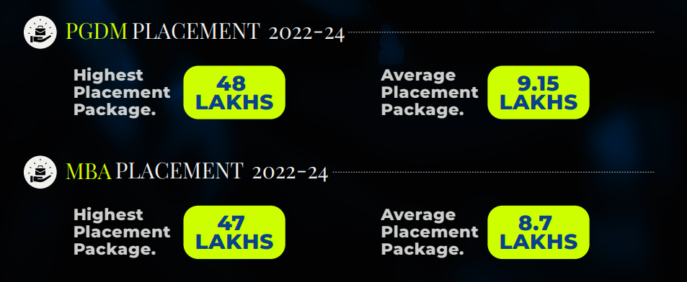
Internship & Placement

Slide 48
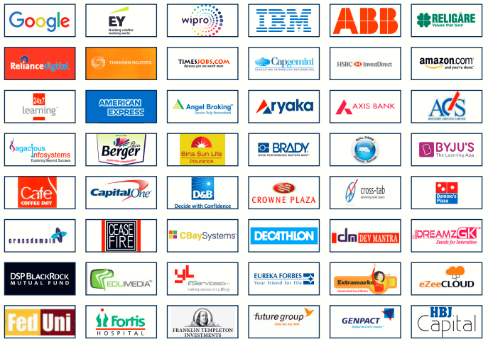
List of Placement Partners

Slide 49

List of Placement Partners

Slide 50


International Boot Camp
French & Japanese Boot camps students get to learn from International Experts about life and culture and the different aspects of International Business.

Slide 51
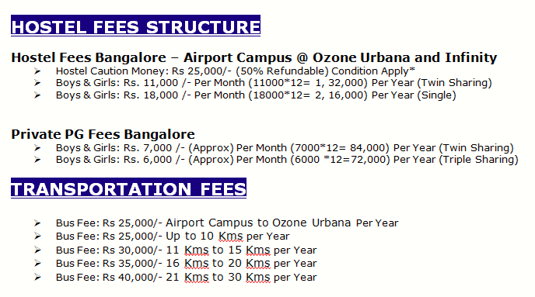
Hostel Fee

Slide 52
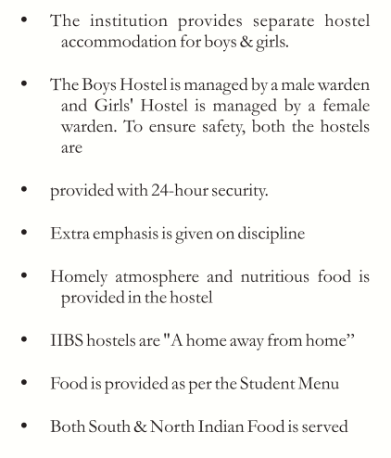
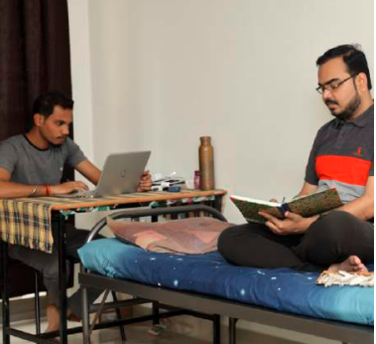
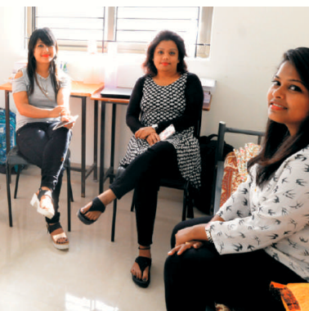
Hostel Facilities

Slide 53

Facilities
Gym
Basket Ball Court
Swimming pool
Indoors Games
Tennis Court
Carom Board
Open Air theatre
ATM
Cricket field
Departmental Store
Club House
Walking Park
Note: All the facilities can be chargeable and subject to availability.

Slide 54
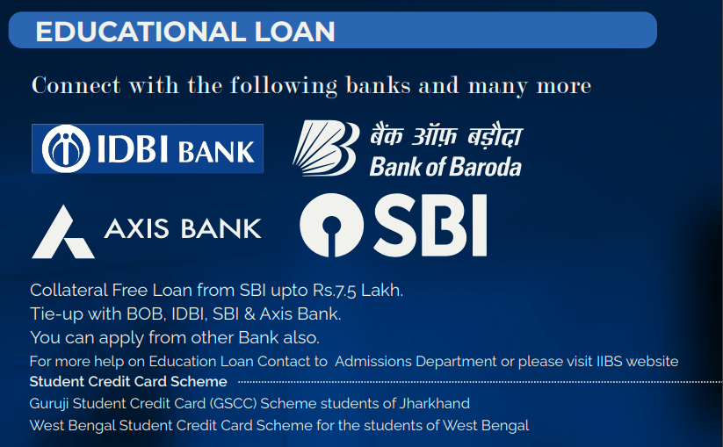
Education Loan

Slide 55
Student Credit Card Scheme
WEST BENGAL Student Credit Card (WBSCC) Scheme for students of West Bengal.
Our College Name has been empanelled
Collateral security free loan up to ₹10 Lakhs@ Nominal Simple Annual interest.
* 4% Rate of Interest, After Placements

Slide 56
JHARKHAND Guruji Student Credit Card (GSCC) Scheme for students of Jharkhand. Our College Name has been empanelled
ZERO Collateral
ZERO Processing Fee
4% Rate of Interest, After Placements UPTO INR *15,00,000/-
Loan Amount For All Category (GEN/OBC/ST/SC)

Slide 57
Bihar Student Credit Card Scheme is Under Process for Empanelment once done will let you know.

Slide 58
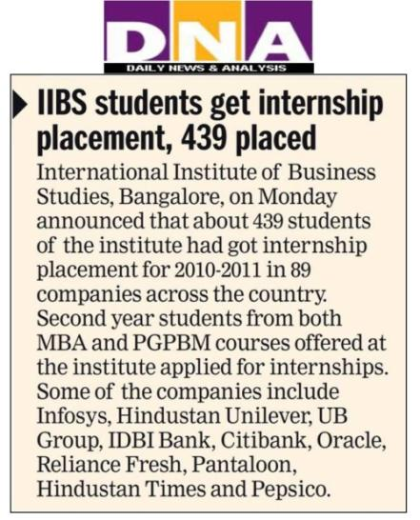
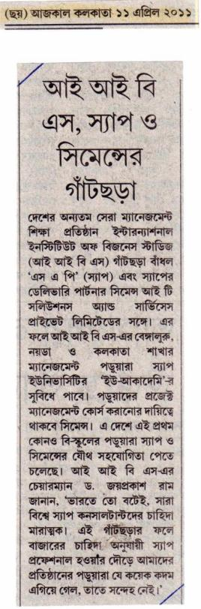
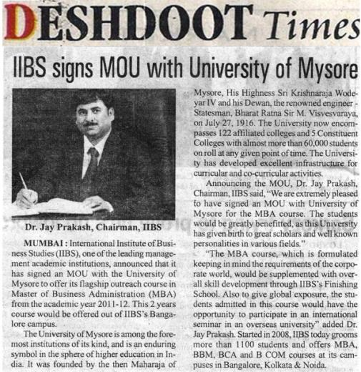

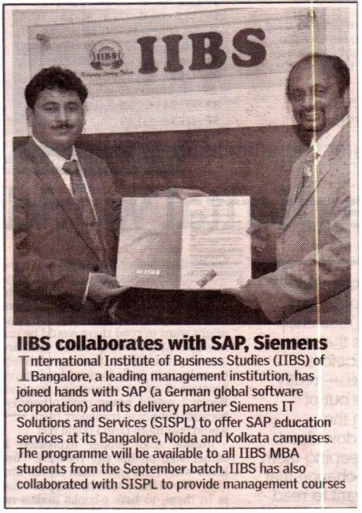
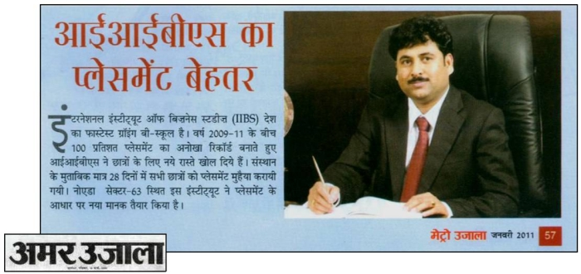
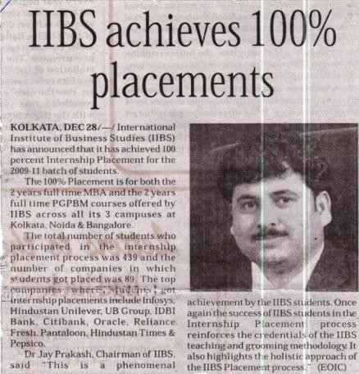
IIBS in Media

Slide 59
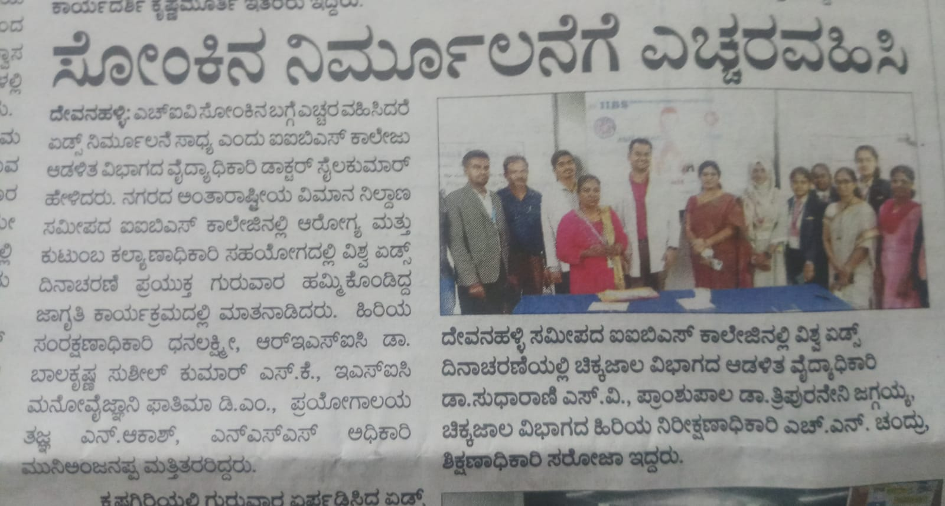
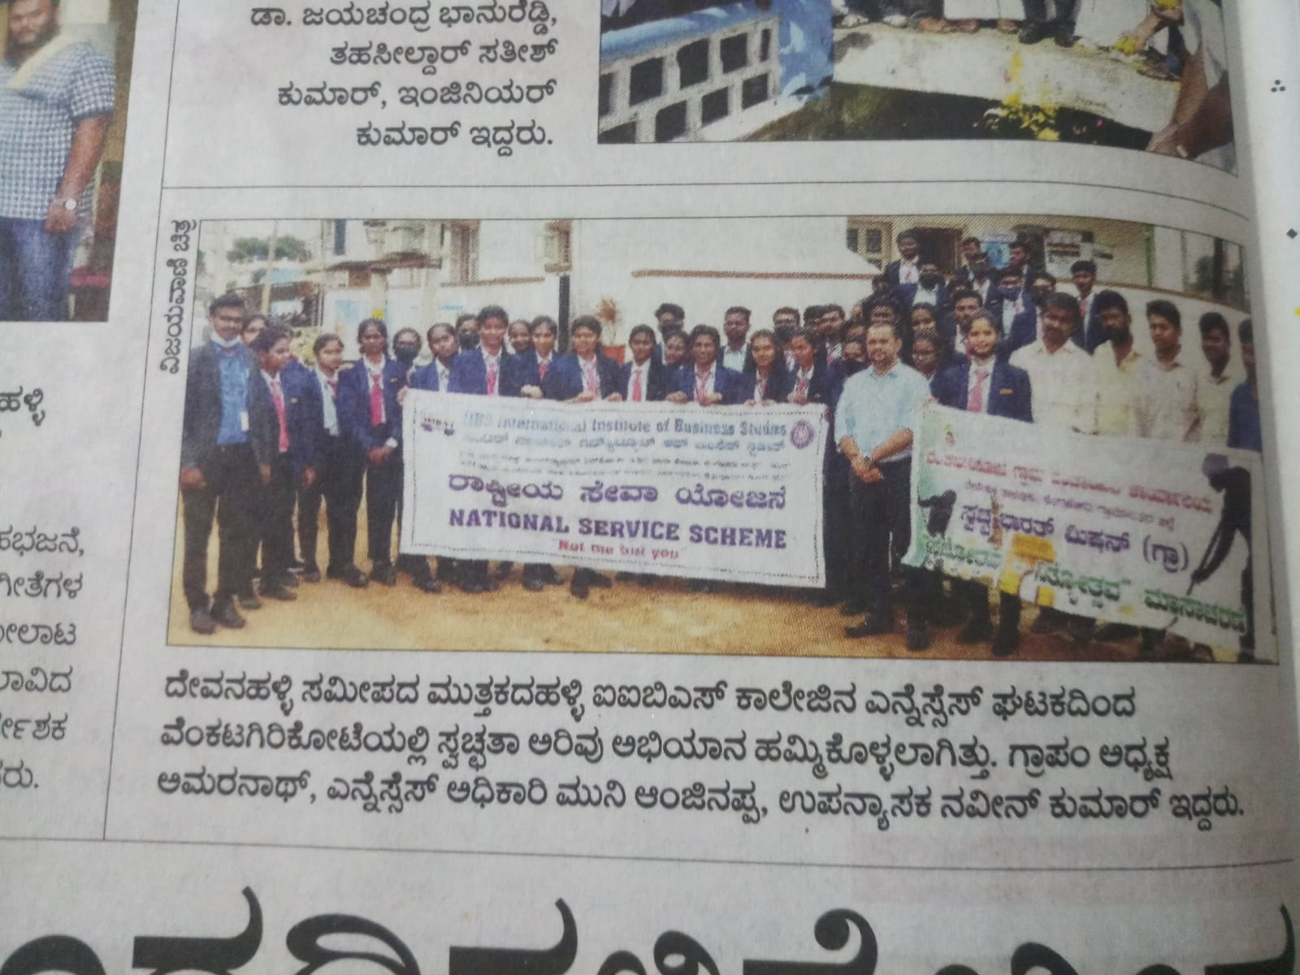
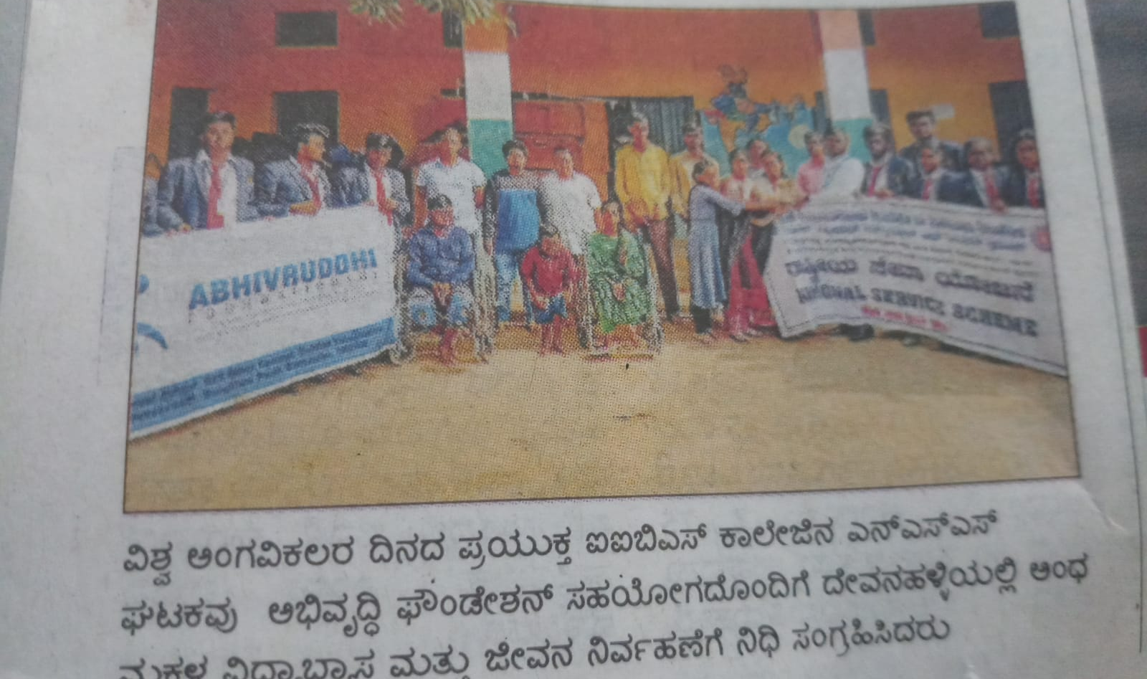
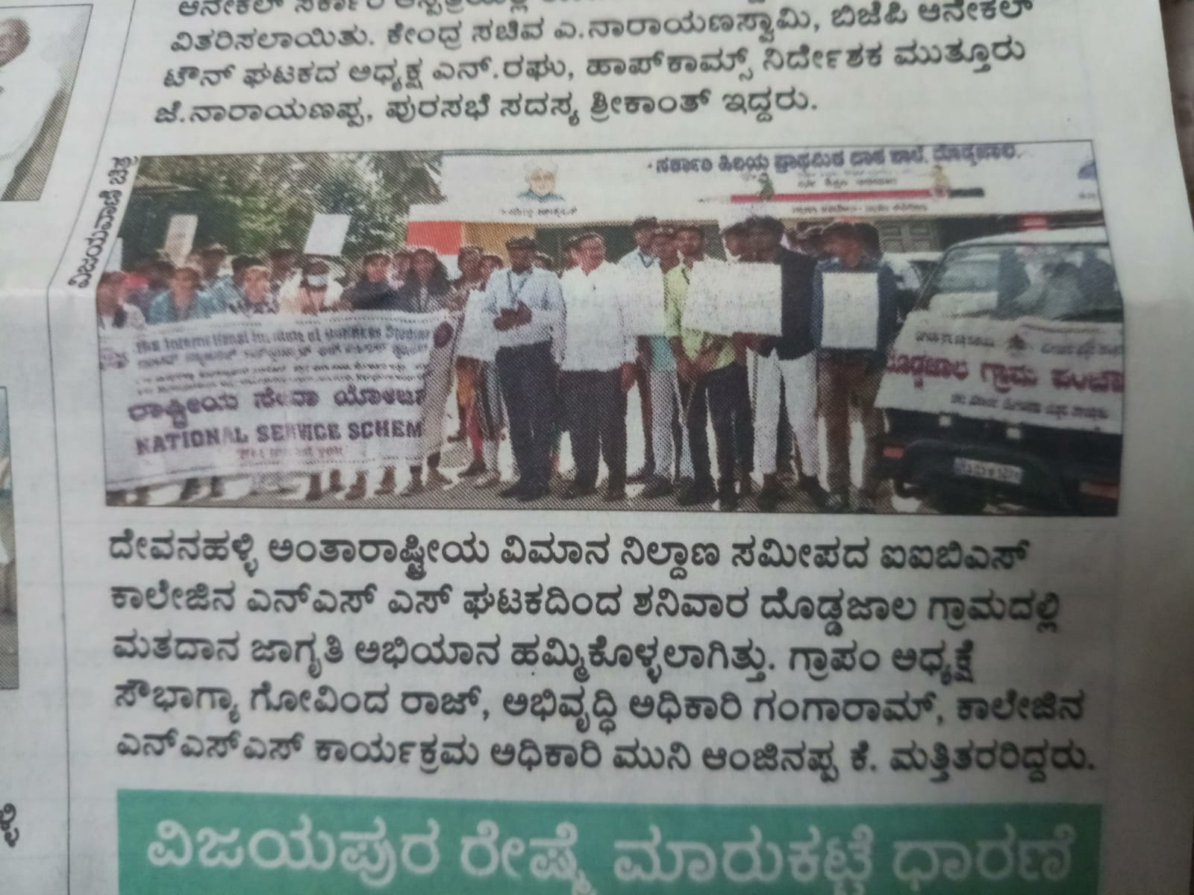

Slide 60
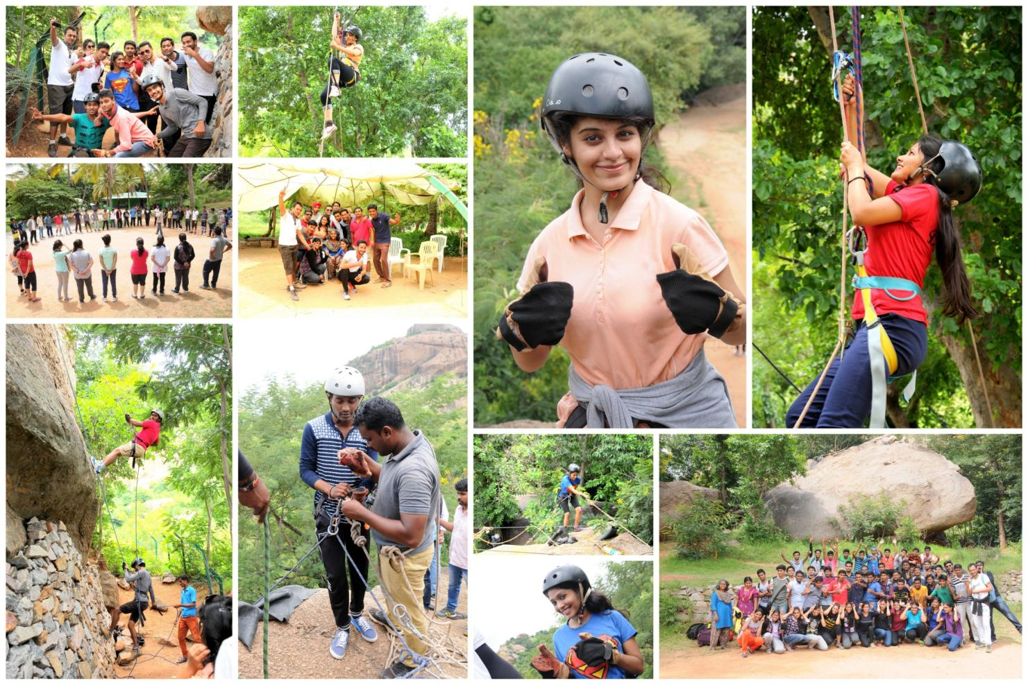
ADVENTURE LEARNING PROGRAMME (ALP)

Slide 61

Life At IIBS
SURFACE PROGRAMME

Slide 62

SURFACE PROGRAMME
IIBS ALUMNI MEET AT BANGALORE

Slide 63

IIBS ALUMNI MEET

Slide 64

CORPORATE NIGHT

Slide 65




IIBS GRADUATION DAY

Slide 66

Bengaluru Campus (Near International Airport)

Slide 67
Contact Us
IIBS NATIONAL HEAD OFFICE
Bangalore (R.T. Nagar)
#119 KHB Main Road, Kanaka Nagar, Nagawara,
R.T. Nagar Post, Bangalore , Karnataka, India
Ph: +91-96202 48214, Ph: +91-99864 15333
BANGALORE CAMPUS
(Near International Airport)
#75, Muthugadahalli, Bangalore North Jala Hobli,
Near International Airport, Bangalore-562157
Ph: +91-99864 15333, +91-96202 48214
Email: admission@iibsonline.com
Website: www.iibs.edu.in | www.iibsonline.com

Slide 68
Good Luck

